Slide 1


STUDENT DETAILS
NAME : ASTHA JAIN
SKILLBUILD EMAIL ID : aforastha@gmail.com
COLLEGE NAME : ACROPOLIS INSTITUTE OF TECHNOLOGY AND RESERCH,INDORE
COLLEGE STATE : MADHYA PRADESH
INTERNSHIP DOMAIN : DATA ANALYTICS
START AND END DATE : 12TH JUNE 2023 – 24TH JULY 2023

Slide 2
ANALYSIS OF SUPERSTORE DATABASE

Slide 3
AGENDA
Problem statement
Project Overview
Tools used
End Users
Business Questions
Statistics
Visualizations/Modeling
Solution
Customization
Links

Slide 4


PROBLEM STATEMENT
Analysis of Sample Superstore Dataset Using python to make future predictions and informed data-driven decisions.

Slide 5
PROJECT OVERVIEW
A Sample Superstore Dataset is given ,which we further Explore, Clean, Analyze, Visualize and then interpret the result .
Super Store is a small retail business located in the United States. They sell Furniture, Office Supplies and Technology products and their customers are the mass Consumer, Corporate and Home Offices. The data set contains sales, profit and geographical information of Super Store.
Our task is to analyze the sales data and identify weak areas and opportunities for Super Store to boost business growth.
Basically it involves Examining datasets in order to find trends and draw conclusions about the information they contain. And Finding possible solutions for increase in sales and profits.

Slide 6








TOOLS USED

Slide 7
THE END USERS
This Project will be used by the owners of the particular Superstore whose data we have used.
We assume that the Super Store is a business owned by 1 or 2 owners who are very invested in their business. Owners are likely not people who are expert in reading charts or interpreting statistical analysis, so our analysis will provide them a solution to there business problems.

Slide 8
ASSUMED BUSINESS QUESTIONS
Which Category is Best Selling and Most Profitable?
Which Customer Segment is Most Profitable?
Which Region is the Most Selling and Most Profitable?
Which State has the Highest Number of Sales?

Slide 9
DESCRIPTIVE STATISTICS
Parameter | Ship Mode | Segment | City | State | Region | Category | Sub-Category
count | 9944 | 9944 | 9944 | 9944 | 9944 | 9944 | 9944
unique | 4 | 3 | 531 | 49 | 4 | 3 | 17
top | Standard Class | Consumer | New York City | California | West | Office Supplies | Binders
frequency | 5930 | 5160 | 906 | 1980 | 3177 | 5986 | 1518
There are 4 ship modes and 3 customer segments. Nearly half of the orders are from Consumer segment using Standard Class shipment.
The store carries 3 category of items with 17 sub-category. 60% of orders are for Office Supplies and at least 15% purchases are for Binders.

Slide 10
STATISTICS
Parameter | Sales | Quantity | Discount | Profit | Profit Margin %
count | 9944.000000 | 9944.000000 | 9944.000000 | 9944.000000 | 9944.000000
mean | 230.752150 | 3.794047 | 0.156440 | 28.770873 | 11.959097
std | 624.644765 | 2.228752 | 0.206584 | 234.841370 | 46.676260
min | 0.444000 | 1.000000 | 0.000000 | -6599.978000 | -275.000000
25% | 17.340000 | 2.000000 | 0.000000 | 1.724800 | 7.500000
50% | 55.000000 | 3.000000 | 0.200000 | 8.679950 | 27.000000
75% | 210.104000 | 5.000000 | 0.200000 | 29.534700 | 36.250000
max | 22638.480000 | 14.000000 | 0.800000 | 8399.976000 | 50.000000
75% of orders makes at least 36% profit margin.
Loss-making orders can go up to 275% losses. We must place emphasis on these loss-making sales to cut them off.

Slide 11
VISUALIZATIONS
We can represent data through use of common graphics, such as charts, plots, infographics, and even animations. These visual displays of information communicate complex data relationships and data-driven insights in a way that is easy to understand.

Slide 12
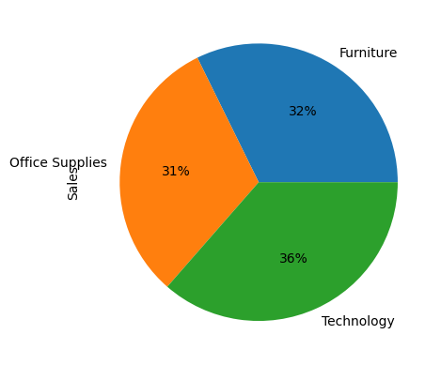
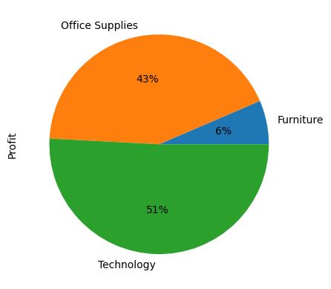
“Technology” has contributed maximum towards sales which is 36%. It is then followed by “Furniture” which is 32%. “Office Supplies” has contributed the least which is 31%.
But at the same time the percentage profit by category chart shows that, where Furniture has a 32% sales but contribute only 6% in profit. It also depicts that Technology and Office Supplies gives a 51% &43% profit respectively.

Slide 13

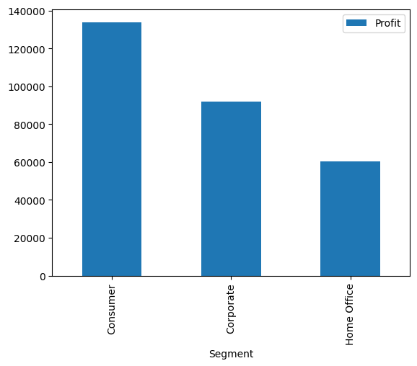
Consumer segment is most profitable, followed by Corporate Segment and Home Office.
Hence, marketing strategy has to target or place more focus on retaining Consumer and Corporate Segment customers.

Slide 14
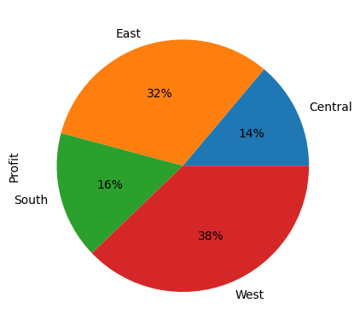
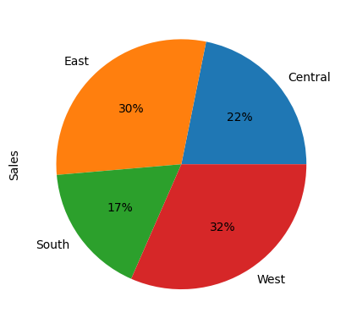
East and West region are most Selling.
Also, East and West region are most profitable.

Slide 15

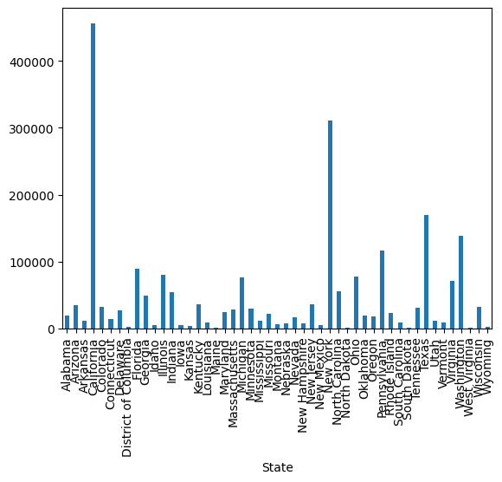
There is a huge disparity between the States with highest sales and lowest sales. Marketing strategy has to target the top 5 States.
Top 5 states with highest sales are :
California
New York
Texas
Washington
Pennsylyania

Slide 16
SOLUTIONS
Focus on Technology Category as it is highest selling and most profitable. Bundle them with the less profitable products.
For Home Offices customers, these people might be busy with work and less likely to spend time selecting individual products, so create a Home Office package with products used for offices.
Consumer and Corporate Segment make up more than 70% of customer base. Target them, especially customers from the East and West region in the Top 5 states with Highest Sales by introducing special promotions and bundles for mass Consumer and Home Offices and send promotional emails or flyers.

Slide 17
CUSTOMIZATION TO MAKE PROJECT MY OWN
I was not sure about where to start, Just wrote my first line of code and so ultimately got some idea for the next step.
Assumed few business questions which helped me stay targeted.
Breaking the project down into smaller units made it easy for me to work.
Mentor guidelines helped a lot in the project.

Slide 18
LINKS
GitHub link :
https://github.com/jainastha14/SUPERSTORE
Sample superstore Dataset :
https://www.kaggle.com/datasets/bravehart101/sample-supermarket-dataset
Drive link :
https://colab.research.google.com/drive/1aJYtbFeChwr8bJOzSP-FMQ8OSeDVyZ_8?usp=drive_link

Slide 19
THANK YOU
“We are surrounded by data, but starved for insights.”

